Slide 1

A Comprehensive Machine Learning Approach to facilitate Loan Approval
19CSE305 : Machine Learning
Team Members:
C Krishna Suhas (AM.EN.U4CSE22115)
Pranav Krishna S (AM.EN.U4CSE22142)
Sahodev Chandro Roy (AM.EN.U4CSE22172)

Slide 2
Problem Statement
This project aims to develop a comprehensive machine learning-based system.
Assess Risk: Accurately predict the likelihood of loan repayment or default.
Automate Decisions: Enable faster and more consistent loan approval decisions.
Minimize Bias: Reduce human biases in the approval process by using explainable AI techniques.
Enhance Profitability: Optimize the trade-off between risk and return for financial institutions.
The project will address challenges such as incorporating domain knowledge, ensuring interpretability of the models, and complying with ethical and legal considerations in decision-making.

Slide 3
Datasets
UCI Credit Approval : https://archive.ics.uci.edu/ml/datasets/credit+approval
Taiwan Credit Risk Default Dataset:
https://archive.ics.uci.edu/dataset/350default+of+credit+card+clients
Default of Credit Card Clients Dataset:
https://www.openml.org/d/42477

Slide 4
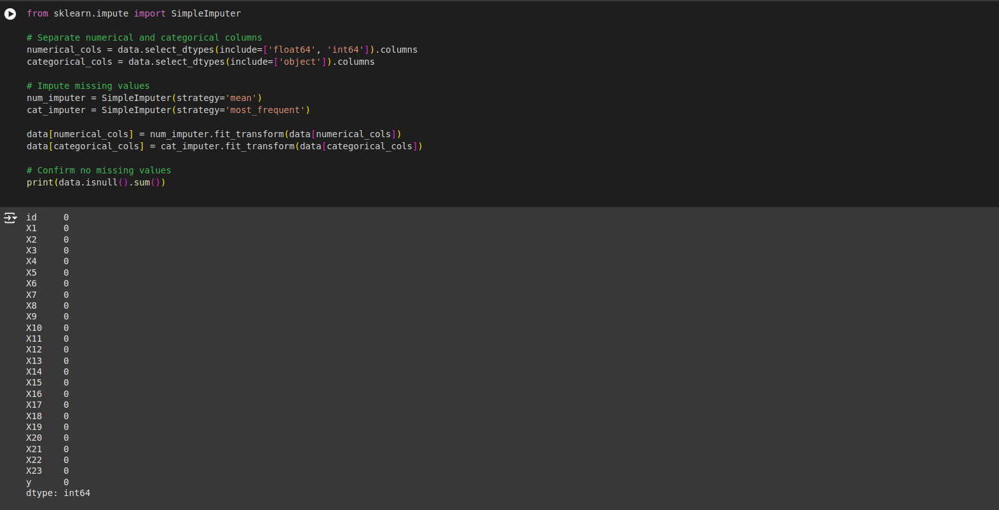
Handling Missing Values
Performed imputation on each dataset.

Slide 5
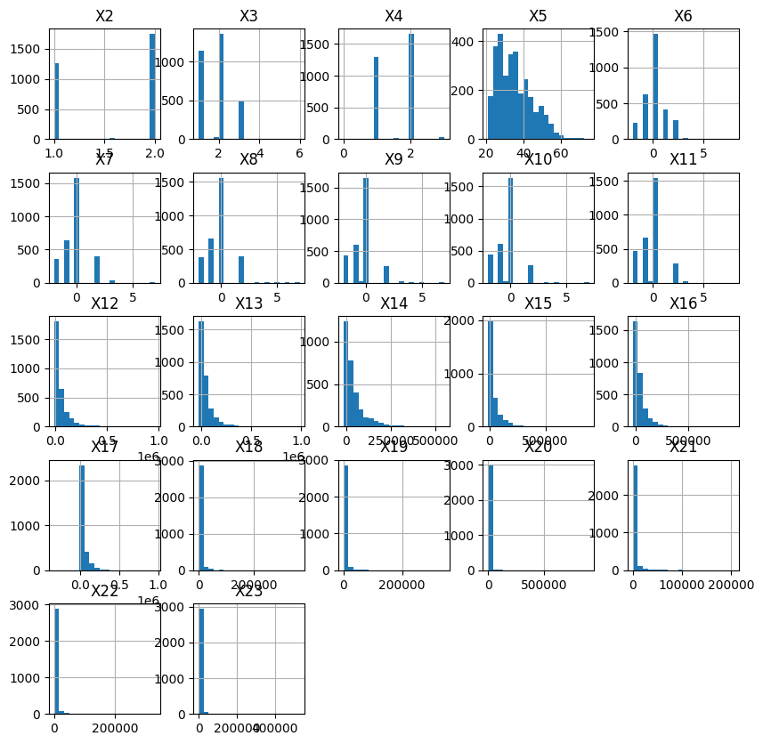
Data Preprocessing
Using histograms to see the distribution of data.

Slide 6
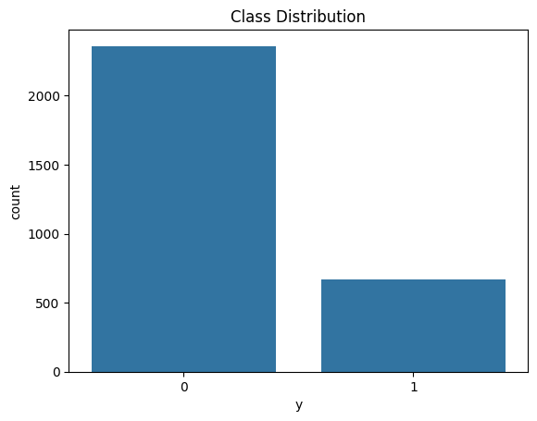
Data Preprocessing
Class balance: The images represents the distribution of values in the target variable ‘y’.
A good majority of the instances side to one class, however, the dataset is partially balanced.
Class Distribution of dataset 2

Slide 7
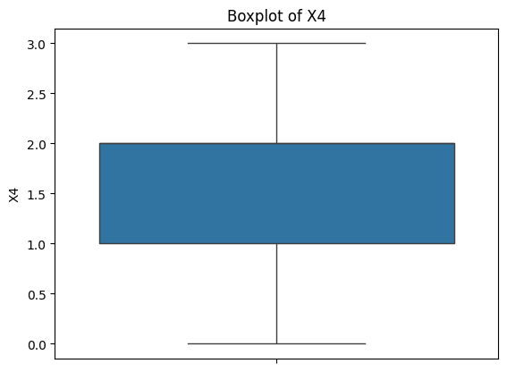
Data Preprocessing
Outlier Detection :
Using a box plot to detect the outliers in the datasets.
Length of whisker = range of data.
Longer box and whiskers represents variability.
Column X4 of dataset 2

Slide 8
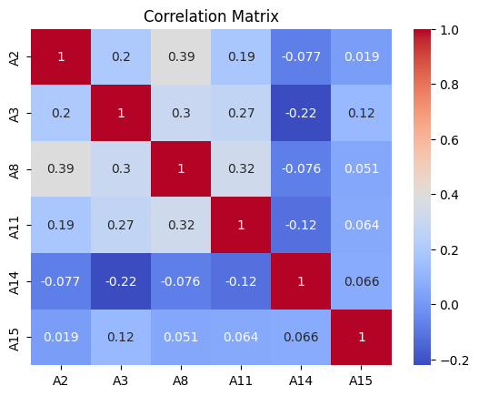
Correlation Matrix
Each cell displays correlation coefficient between two variables.
Correlation Coefficient: values range from -1 to 1:
1: Perfect positive correlation (variables move in the same direction).
-1: Perfect negative correlation (variables move in opposite directions).
0: No correlation (variables are independent).
Column X4 of dataset 2

Slide 9
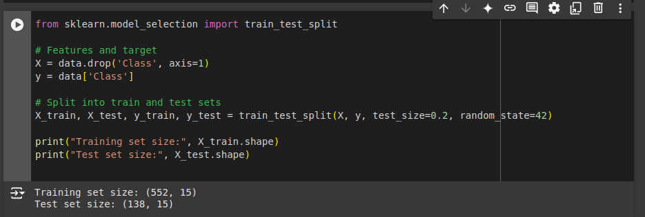
Splitting the datasets
Target variable name : Class (dataset1)
Partitions : Train and Test

Slide 10
Logistic Regression
Primarily used for binary classification problems.
Converts the probability into a predicted class label using a threshold (default: 0.5 for binary classification).
Advantages :
Simple and Interpretable.
Computationally Efficient.
Directly models decision boundary btw classes.

Slide 11
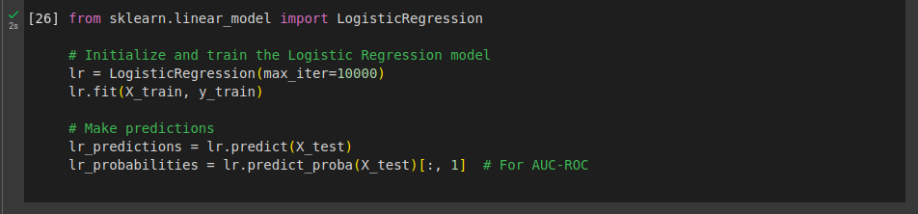
Logistic Regression

Slide 12
Decision Tree
It works by recursively splitting data into subsets based on feature values to make predictions.
The data is divided into subsets that are more homogeneous in nature.
Advantages:
Non-parametric : no prior assumption about data.
Can handle both numerical and categorical data.
Mimics human decision making.

Slide 13
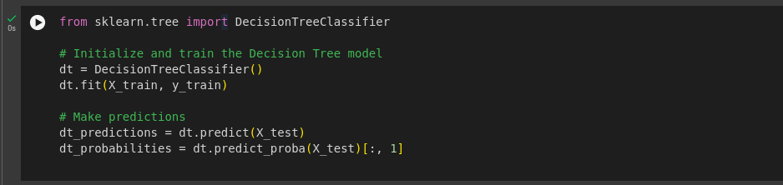
Decision Tree

Slide 14
Random Forest
Ensemble Learning Method that builds multiple decision trees and combines their outputs to improve accuracy and robustness.
Outputs are determined by majority voting.
Advantages:
Robustness : Reduces overfitting compared to individual decision trees.
High Dimensionality : Works well with large feature sets.
Non-parametric : Makes no assumptions about data distribution.

Slide 15
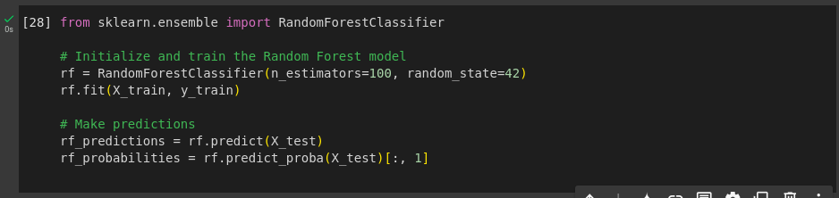
Random Forest

Slide 16
Ensemble Learning
Ensemble learning is a technique where multiple models are combined to solve a problem or improve prediction performance.
The idea is that a group of models, when combined, can outperform individual models by reducing errors and improving generalization.
Random forest comes under bagging (bootstrap aggregating) where the aim is to reduce variance by training multiple models on different subsets of the training data and predictions based on average or majority voting.

Slide 17
Gradient Boosting
It is an Ensemble Learning Method that builds models sequentially, where each new model corrects the errors of the previous ones.
Widely used for both classification and regression tasks and excels in predictive accuracy.
It comes under Boosting which aims to reduce bias by sequentially training models, where each new model corrects the errors of the previous ones.
Advantages : High Predictive Accuracy, Can model complex relationships and able to handle both numerical and categorical data.

Slide 18
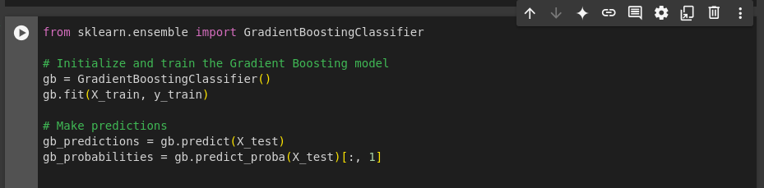
Gradient Boosting

Slide 19
Evaluation Metrics
Accuracy: Overall correctness of predictions.
Precision: Proportion of positive predictions that are actually positive.
Recall: Proportion of actual positive cases correctly identified.
F1-Score: Harmonic mean of precision and recall, balancing both.
AUC-ROC: Area Under the Receiver Operating Characteristic curve, measuring a model's ability to distinguish between positive and negative classes.

Slide 20
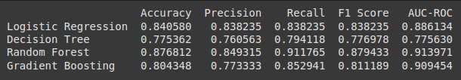
Dataset 1 - Results
Overall Best Model: Random Forest is the most suitable model for this task due to its consistently high metrics, including accuracy, precision, recall, F1 Score, AUC-ROC.
Alternative Model: Gradient Boosting can be considered if the goal is to explore more robust ensemble techniques or prioritize slightly better recall.

Slide 21
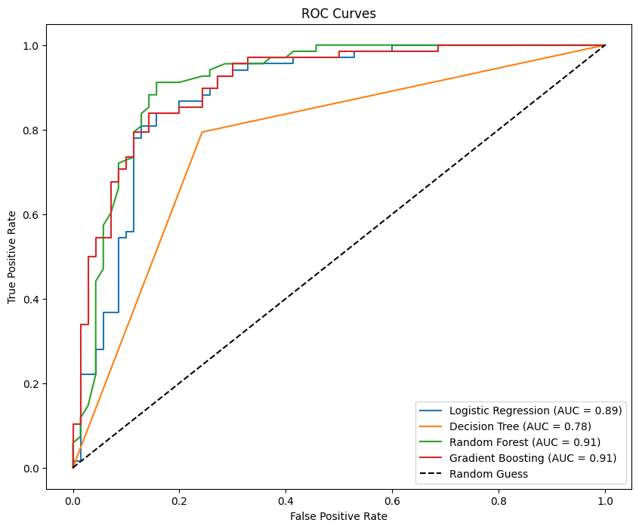
Dataset 1 – ROC Curve

Slide 22

Dataset 2 - Results
Gradient Boosting: Best choice if we prioritize overall model performance based on AUC-ROC and precision.
Random Forest: Preferred for a simpler model with good balance across metrics, especially for recall-focused applications.

Slide 23
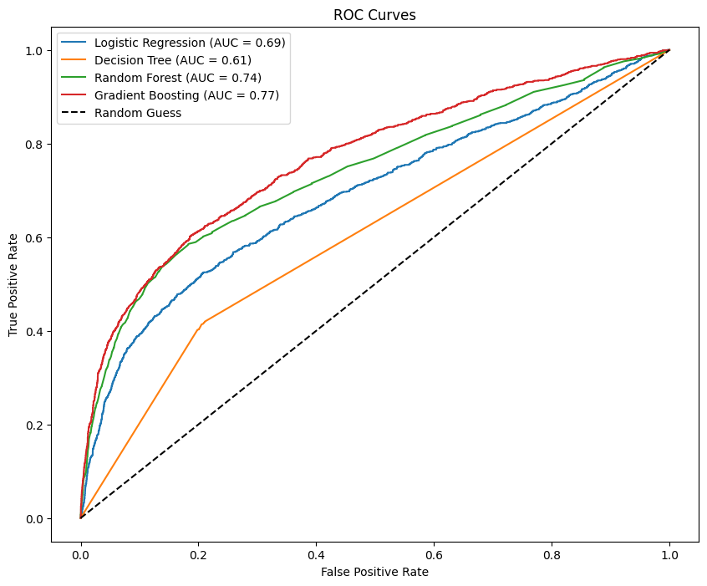
Dataset 2 – ROC Curve

Slide 24
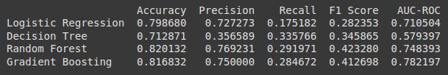
Dataset 3 - Results
Balanced Metric: Logistic Regression performs the best (F1 Score: 0.690) for a balance between precision and recall.
Ranking by AUC-ROC: Gradient Boosting > Random Forest > Logistic Regression > Decision Tree.

Slide 25
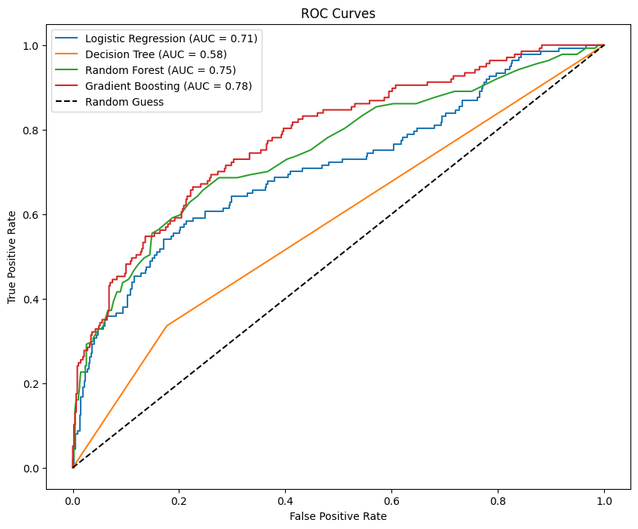
Dataset 3 – ROC Curve

Slide 26
Conclusion
For high predictive accuracy , Gradient Boosting is the best choice and for overall performance and good balance across all metrics, Random Forest or Logistic Regression would be more preferable
For simpler datasets, Decision Tree or Logistic Regression would be more suitable.
The ideal choice of algorithm certainly depends on the datasets, our analysis is mainly to determine the effectiveness of these algorithms on the provided datasets to provide further insights.

Slide 27


